Slide 1
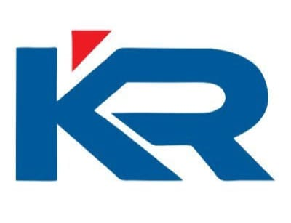

PLI BLOCKATHON
INDIA ‘22
FARMCHAIN : Farmer – Merchant Network
MR. A. ADHITHYA
MR. A. RHAMATHULLA
MR. J. MITHUNRAJ
MS. G. SUJAINITHA
MRS. A. DHIVYA BHARATHI
MENTOR

Slide 2
PROBLEM STATEMENT :
Fetch Resonable Prices For Their Produce Due To The Intervention Of Middlemen In Market.
Analysing Market Trends And Customer Needs.Currently The Farmer And Customer Are Completely Separated In The Market By Middlemen.

Slide 3
HOW CAN BLOCKCHAIN SOLVE THESE PROBLEMS:
Improve Transparency In The Supply Chain:
Consumers Demand For “Clean” Food Including Organic.
Consumers are Willing To Pay For The Information.
Traceability Of Consumers:
Open and Shared Ledger System Will Trace Product Origin With Immutable Provenance Data From Farm To Table.
Retails Can Verify Easily That The Product They Are Receiving Is Exactly What They Paid For.

Slide 4
Expand Financial Options For Farmers:
Farmers Particularly In Developing Economies, Have Limited Access To Financial Resources.
Blockchain Technology Provides Farmers With The Ablility To Show What They Have Harvested.
Provides Quicker Access To Funding Resources And Make Farmers Financially Inclusive.
Immediate Payment On Delivery:
Farmers Often Must Wait Weeks Or Months To Be Paid After Delivering And Improve Settlement Process For Farmers.

Slide 5
Farmers Has Direct Access To Suppliers And Market Information:
Farmers Are Able To Determine What Their Harvest Is Currently Worth And Sell At A Price That Reflects Global Market Conditions.
Information Sharing Will Increase Industrial Competition, And Price Will Become Higher.

Slide 6
ARCHITECTURE DIAGRAM:
DECENTRALIZED
DATA
BLOCKCHAIN
TECHNOLOGY
DATA
DECENTRALIZED
LOCATION
NEEDED GOODS
QUANTITY
QUANTITY NEEDED
COST
LOCATION
FARMER
MERCHANT
REVIEWS
PHONE NO
PHONE NO
TRANSACTION VERIFIED

Slide 7

FRONT END LANGUAGE USED:
We Have Used HTML Language As The Front End In Our Application.
HTML – Hypertext Markup Language.
Hypertext Defines The Link Between Web Pages .
The Markup Language Is Used To Define The Text Documentation Within The Tag Which Defines The Structure Of Web Pages.

Slide 8

BACK END LANGUAGE USED:
We Have Used GOLANG As The Backend In Our Application.
GOLANG Is A Procedural And Statically typed Programming Language.
It Provides A Rich Standard Library, Garbage Collection, And Dynamic Typing Capability.
This Is The Most Trending Programming languages Among Developers.

Slide 9
ADVANTAGES OF USING BLOCKCHAIN IN AGRICULTURE:
TRUST
REDUCED
COSTS
SPEED
TOKENIZATION
ADVANTAGES
IMMUTABILITY
SECURITY
&
PRIVACY
INDIVIDUAL
CONTROL OF
DATA
DECENTRALIS-ED STRUCTURE

Slide 10
FUTURE OF BLOCKCHAIN TECHNOLOGY IN AGRICULTURE:
No Large Scale Commercial Adoption Of Blockchain Yet: Still Many Bottlenecks To Remove.
The Challenge Now For Blockchain, And Agricultural Technologies Is Connecting The Technology To Viable Business Models And Compelling Use Cases.
Blockchain Technology Has The Ability To Fundamentally Transform The Agriculture Industry.
Agriculture As The Last Frontier Of Blockchain.

